Slide 1

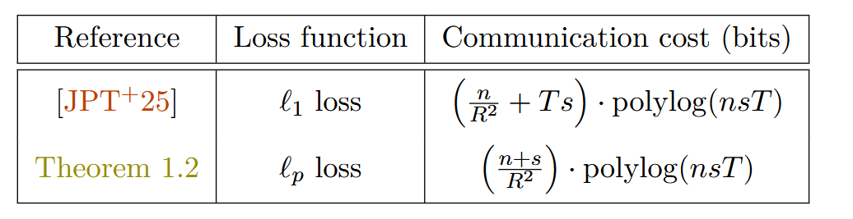
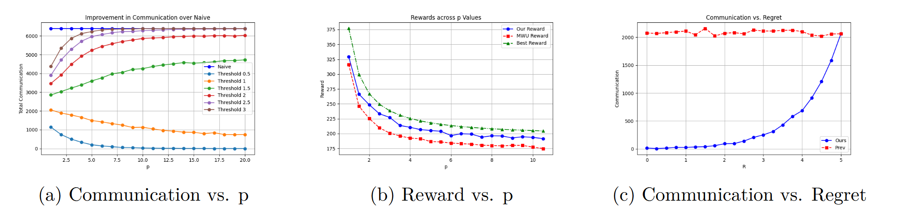
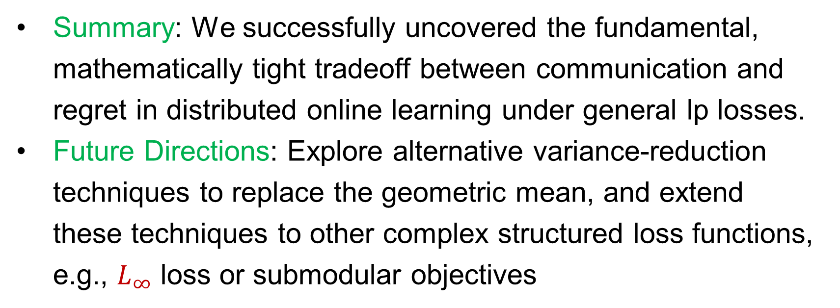
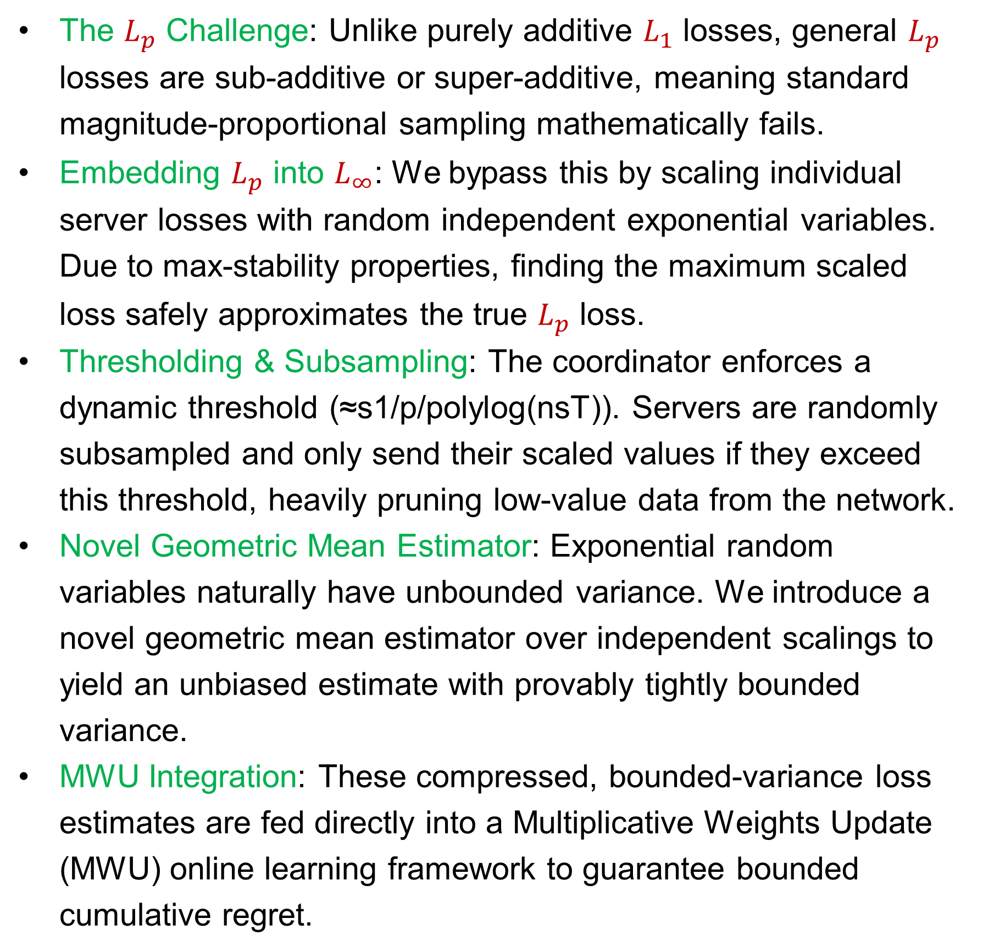
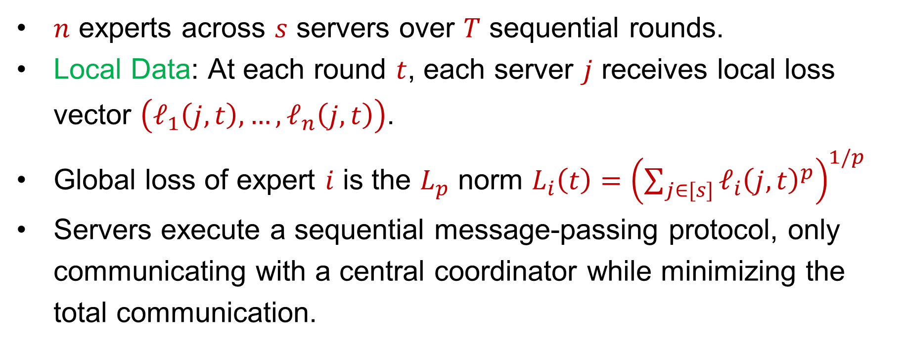
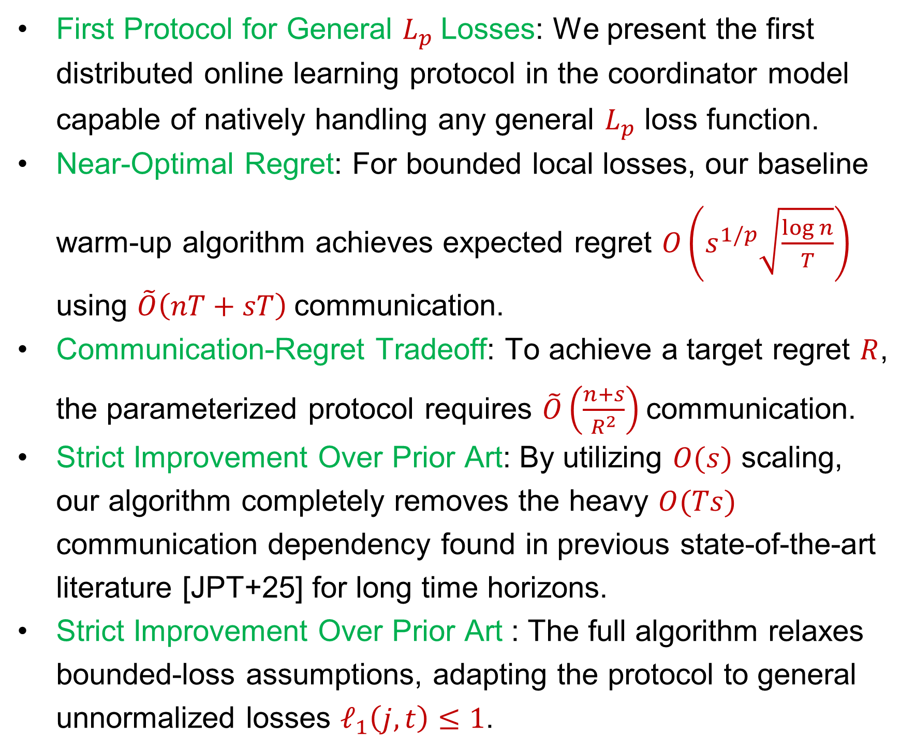
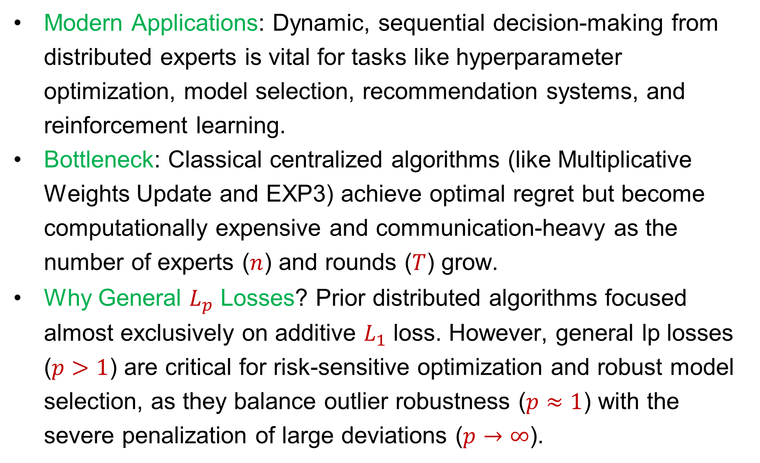
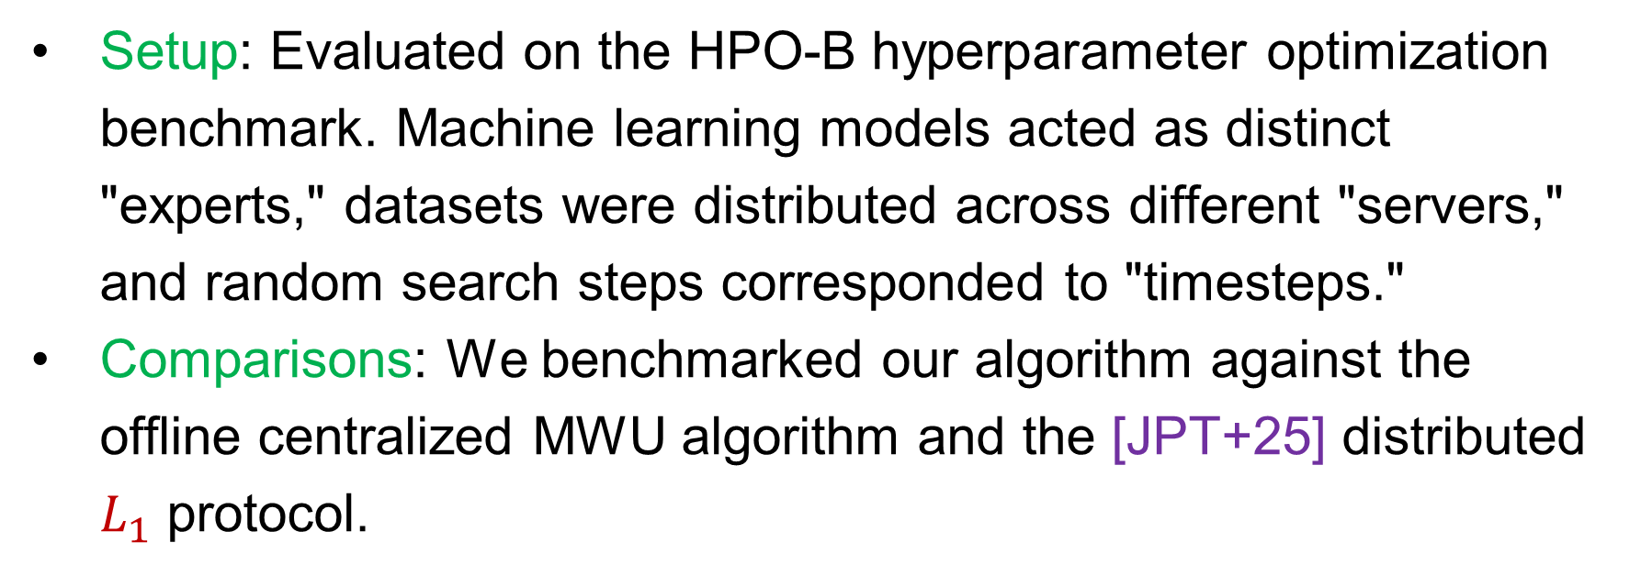
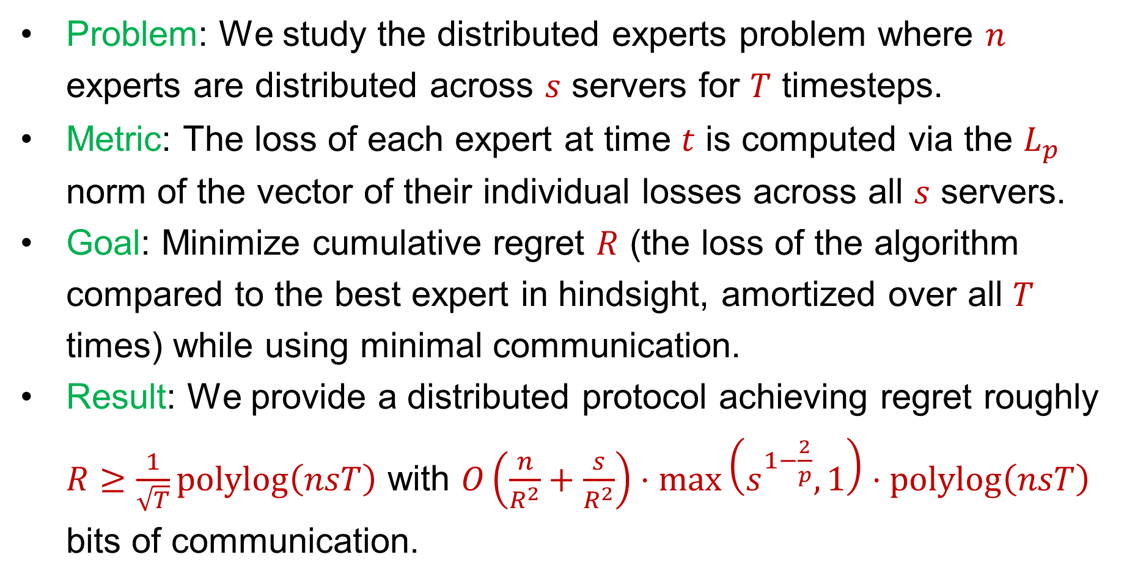
Better Bounds for the Distributed Experts Problem
David P. Woodruff (Carnegie Mellon University)
Samson Zhou (Texas A&M University
Main Theoretical Contributions
Algorithmic & Technical Novelties
Abstract & Overview
First Protocol for General $L_{p}$Losses: We present the first distributed online learning protocol in the coordinator model capable of natively handling any general​ $L_{p}$ loss function.
Near-Optimal Regret: For bounded local losses, our baseline warm-up algorithm achieves expected regret $O\left(s^{1/p}\sqrt{\frac{\log{n}}{T}}\right)$ using $\tilde{O}\left(nT+sT\right)$communication.
Communication-Regret Tradeoff: To achieve a target regret $R$, the parameterized protocol requires $\tilde{O}\left(\frac{n+s}{R^{2}}\right)$communication.
Strict Improvement Over Prior Art: By utilizing $O(s)$ scaling, our algorithm completely removes the heavy $O(Ts)$ communication dependency found in previous state-of-the-art literature [JPT+25] for long time horizons.
Strict Improvement Over Prior Art : The full algorithm relaxes bounded-loss assumptions, adapting the protocol to general unnormalized losses $ℓ_{1}\left(j,t\right)≤1$.
The $L_{p}$ Challenge: Unlike purely additive $L_{1}$ losses, general $L_{p}$ losses are sub-additive or super-additive, meaning standard magnitude-proportional sampling mathematically fails.
Embedding $L_{p}$ ​into $L_{∞}$​: We bypass this by scaling individual server losses with random independent exponential variables. Due to max-stability properties, finding the maximum scaled loss safely approximates the true $L_{p}$ loss.
Thresholding & Subsampling: The coordinator enforces a dynamic threshold (≈s1/p/polylog(nsT)). Servers are randomly subsampled and only send their scaled values if they exceed this threshold, heavily pruning low-value data from the network.
Novel Geometric Mean Estimator: Exponential random variables naturally have unbounded variance. We introduce a novel geometric mean estimator over independent scalings to yield an unbiased estimate with provably tightly bounded variance.
MWU Integration: These compressed, bounded-variance loss estimates are fed directly into a Multiplicative Weights Update (MWU) online learning framework to guarantee bounded cumulative regret.
Problem: We study the distributed experts problem where $n$ experts are distributed across $s$ servers for $T$ timesteps.
Metric: The loss of each expert at time $t$ is computed via the $L_{p}$​ norm of the vector of their individual losses across all $s$ servers.
Goal: Minimize cumulative regret $R$ (the loss of the algorithm compared to the best expert in hindsight, amortized over all $T$ times) while using minimal communication.
Result: We provide a distributed protocol achieving regret roughly $R≥\frac{1}{\sqrt{T}}polylog\left(nsT\right)$ with $O\left(\frac{n}{R^{2}}+\frac{s}{R^{2}}\right)⋅\max\left(s^{1−\frac{2}{p}},1\right)⋅polylog\left(nsT\right)$ bits of communication.
Introduction & Motivation
Modern Applications: Dynamic, sequential decision-making from distributed experts is vital for tasks like hyperparameter optimization, model selection, recommendation systems, and reinforcement learning.
Bottleneck: Classical centralized algorithms (like Multiplicative Weights Update and EXP3) achieve optimal regret but become computationally expensive and communication-heavy as the number of experts ($n$) and rounds ($T$) grow.
Why General $L_{p}$ Losses? Prior distributed algorithms focused almost exclusively on additive $L_{1}$​ loss. However, general lp​ losses ($p>1$) are critical for risk-sensitive optimization and robust model selection, as they balance outlier robustness ($p≈1$) with the severe penalization of large deviations ($p→∞$).
Empirical Evaluations
Conclusion & Future Work
Setup: Evaluated on the HPO-B hyperparameter optimization benchmark. Machine learning models acted as distinct "experts," datasets were distributed across different "servers," and random search steps corresponded to "timesteps."
Comparisons: We benchmarked our algorithm against the offline centralized MWU algorithm and the [JPT+25] distributed $L_{1}$ protocol.
Summary: We successfully uncovered the fundamental, mathematically tight tradeoff between communication and regret in distributed online learning under general lp​ losses.
Future Directions: Explore alternative variance-reduction techniques to replace the geometric mean, and extend these techniques to other complex structured loss functions, e.g., $L_{∞}$ loss or submodular objectives
Problem Setting (Coordinator Model)
$n$ experts across $s$ servers over $T$ sequential rounds.
Local Data: At each round $t$, each server $j$ receives local loss vector $\left(ℓ_{1}\left(j,t\right),…,ℓ_{n}\left(j,t\right)\right)$.
Global loss of expert $i$ is the $L_{p}$ norm $L_{i}\left(t\right)={\left(\sum_{j∈[s]}{ℓ_{i}{\left(j,t\right)}^{p}}\right)}^{1/p}$
Servers execute a sequential message-passing protocol, only communicating with a central coordinator while minimizing the total communication.
References
[JPT+25] Zhihao Jia, Qi Pang, Trung Tran, David Woodruff, Zhihao Zhang, and Wenting Zheng. Communication bounds for the distributed experts problem. NeurIPS 2024

